Slide 1
Program Summary
Kerl Tsahey

Slide 2
Introduction
Kerl Sena Tsahey
The great philosopher, Plato, once said, “The beginning is the most important part of the work.” How can you accomplish great things if you never get started?

Slide 3
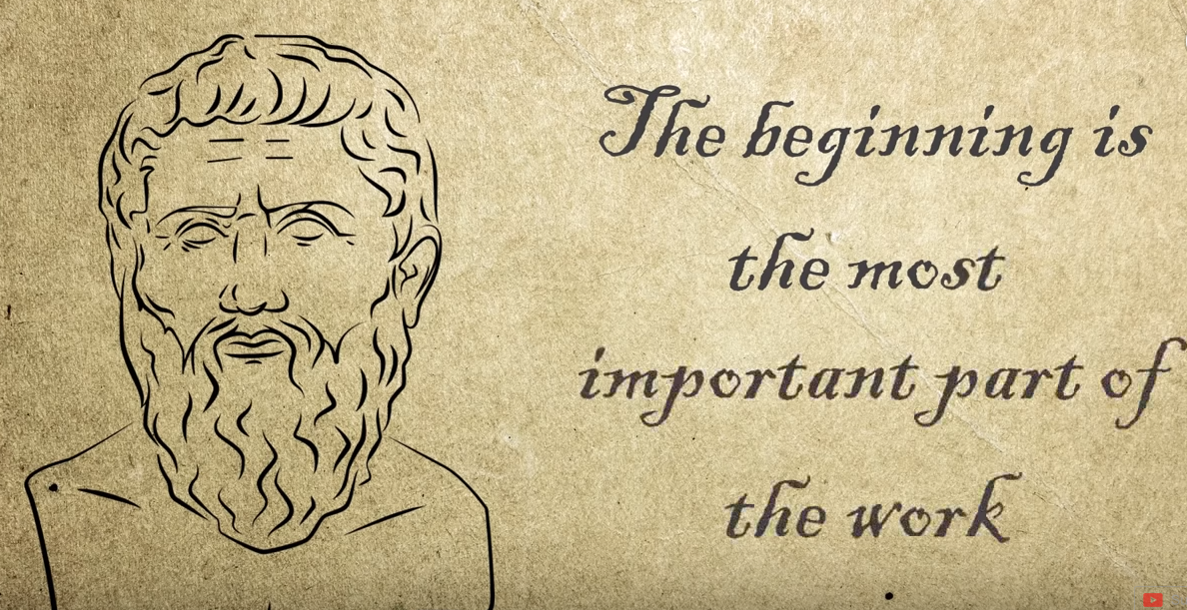

Slide 4
FUNDERMENTALS OF COMPUTING
The Purpose of this Section is to:
Provide a High –Level Introduction
To Computing using
Oversimplification of Concepts
for the purpose of providing a
Frame-of-Reference
for you to move forward …

Slide 5
FUNDERMENTALS OF COMPUTING CONT..
What Is a Computer
Computers and their components
Types of Computers
Types of Software
Network Architectures
Network components
Types of Networks

Slide 6
FUNDERMENTALS OF COMPUTING
What Is A Computer ?
What is a Server?
What is an Instance?

Slide 7
IT DEPT ORGANIZATIONAL STRUCTURE
Information Technology (IT)
Application Development
Application management
IT management & Administration
Business Intelligence (BI)

Slide 8
IT DEPT ORGANIZATIONAL STRUCTURE CONT….
IT Procurement
IT Security
Network Administration
Systems Analyst & System Architect
User Support Services
ITIL

Slide 9
SYSTEM AND DATABASE ADMINISTRATION
What is a System
Types of Systems
What is a Database
Types of Databases
Intro to Database Administration

Slide 10
OPERATING SYSTEMS
The Purpose of this Section is to:
Provide a High –Level Introduction
To Operating Systems using
Oversimplification of Concepts
for the purpose of providing a
Frame-of-Reference
for you to move forward …

Slide 11
OPERATING SYSTEMS
Introduction to Windows OS
Introduction to Linux OS
What is GUI?
What is CLI?

Slide 12
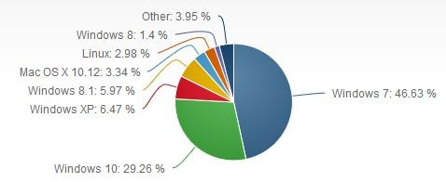
DESKTOP COMPUTER (OS) MARKET SHARE

Slide 13
SYSTEM ADMINISTRATION BASICS
Windows Server Administration
Linux Server Administration
Introduction to Virtualization
Remote Connections
SSH

Slide 14
Network Components
Network Interface Card (NIC)
Hub
Switches
Cables and connectors
Router
Modem
Firewalls
IP’s
Ports

Slide 16
CLOUD COMPUTING
Cloud computing is the practice of accessing remote servers via the internet to store, manage, and process data, rather than a local Server/Datacenter or personal computer . Cloud services are broadly divided into three categories:
Infrastructure-as-a-Service (IaaS),
Platform-as-a-Service (PaaS) and
Software-as-a-Service (SaaS).

Slide 17
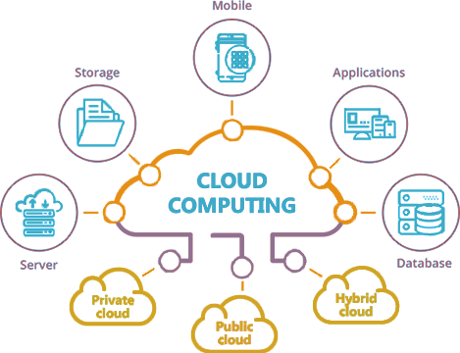
CLOUD COMPUTING CONT…

Slide 18
Why Cloud Computing?
Advantages or Pros
Accessible Everywhere-No geographical barrier(HA)
Pay Per Use-Pay for what you need
More economical/Cheap-Pool of resource for many people/multi tenant
Faster Deployment
Disaster recovery( Fault Tolerance)
Scalability and Elasticity
Disadvantages or Cons
Compliance-Enforcement can become more complicated
Legal-Laws and Regulations vary by Geographic regions and Countries
Data Security Concerns –Data is Managed by different entities and delivered over the internet (CIA)

Slide 19
CLOUD PROVIDERS
Amazon Web Services (AWS)
Google Cloud Platform (GPC)
Microsoft Azure
VMware
IBM Cloud
Salesforce
Oracle Cloud etc. etc..

Slide 20
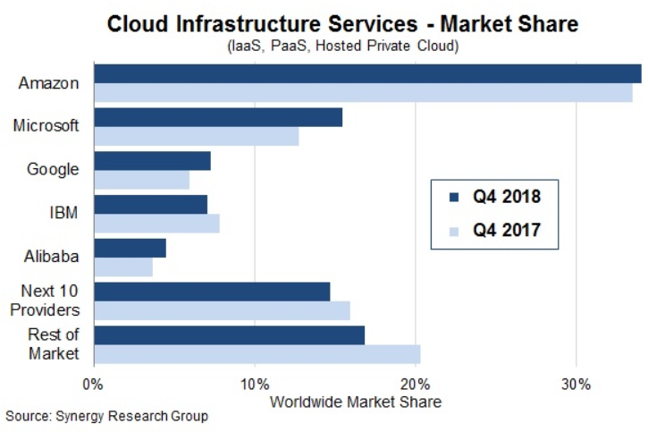
CLOUD PROVIDERS CONT.
1 quadrillion Metric observations monitored each month by Amazon CloudWatch
4,800+ Software listings ready to be deployed in AWS Marketplace
$100s of millions Customer savings every year with AWS Trusted Advisor
1M+ Active customers of Amazon CloudWatch per week

Slide 21
CLOUD PROVIDERS CONT…
Amazon Web Services (AWS) :EC2, S3, RDS…..
Google Cloud Platform services(GCP): Cloud Functions, App Engine, Kubernates, Cloud SQL, Cloud Spanner, etc..
Microsoft Azure Services: Virtual Machines, Azure SQL Database, Cosmos DB, Windows Virtual Desktop, App Service….

Slide 22
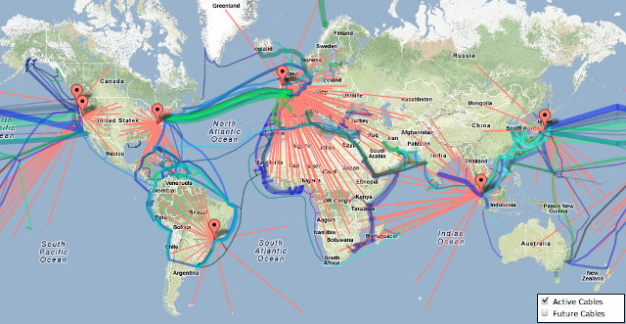
AWS PHYSICAL DATACENTER LOCATIONS

Slide 23

QUESTIONS

